Slide 1
The world energy problem and ways to solve it
Fyodor Malchik

Slide 2
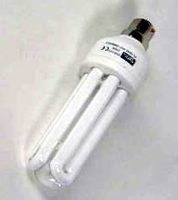
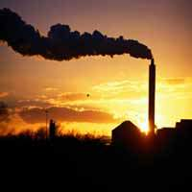
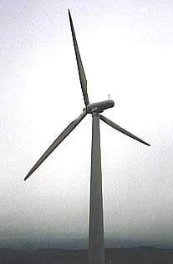
The Energy crisis
We are running out of energy.
We need think about how we will make energy in the future.

Slide 3
Imagine you were running the country. What types of energy would you use?
Wind, sea, nuclear, solar, coal?
Look at the different types of energy then discuss your choices.

Slide 4
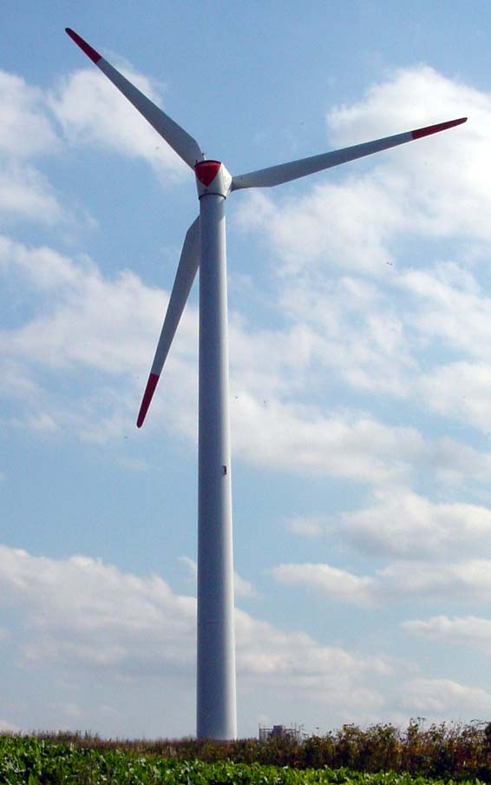
Wind power
Onshore wind power has the potential to provide a valuable income for rural Wales, particularly to farmland communities in upland areas.
Advantages | Disadvantages
Renewable. Non-polluting. A well proven technology. | Does not produce power when the wind isn't blowing. Local residents are often against development as it changes the local landscape.

Slide 5
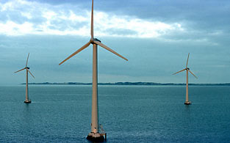
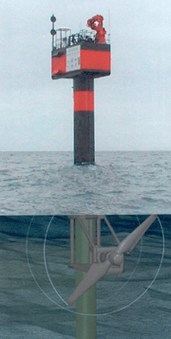
Sea power
The sea around the Welsh coast has the potential to generate large amounts of electricity by harnessing the power of the tides, currents and Waves. Wales has strong sea currents and some of the highest tidal ranges in the world.
Plans are being discussed for Swansea Bay, Severn Estuary and Liverpool Bay.
Advantages | Disadvantages
Renewable. Non-polluting. | Relatively new technology. Local residents are often against development as it changes the local landscape.

Slide 6
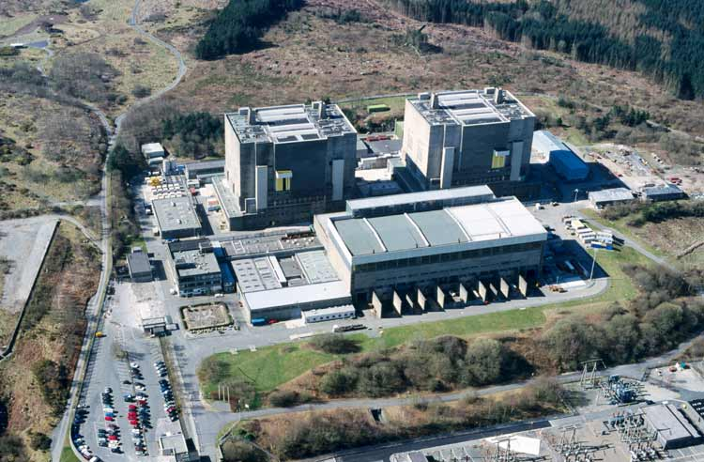
Nuclear power
There are currently 16 nuclear power plants in Britain – all will close by 2023.
The idea is that other renewable energy sources will replace nuclear power production and relieve Britain's reliance on fossil-fuels. However, the government is currently being advised to build further nuclear power stations if they are to meet greenhouse gas emission targets.
This picture shows Trawsfynydd nuclear power station in the Snowdonia National Park. It closed in 1993. The nuclear reactors are still held within the building.
Advantages | Disadvantages
Relatively cheap to make. Does not contribute to the greenhouse effect. Produces huge amounts of energy from small amounts of fuel. | Nuclear power produces toxic radioactive waste which will last for tens and thousands of years. Nuclear power stations and the trains, lorries and ships that transport nuclear fuel waste could be an easy and devastating target for terrorists.

Slide 7
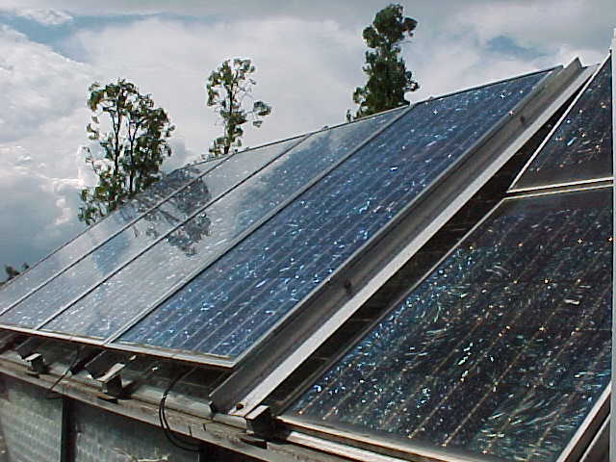
Solar power
Solar roof tiles use light from the sun to create electricity or hot water.
Houses with lots of tiles could generate more electricity than they use – this could be sold back to local electricity companies.
Advantages | Disadvantages
It is a well proven technology. Well suited to providing power in home or single building applications. Renewable. | They are expensive to buy. Making them requires a lot of energy.

Slide 8
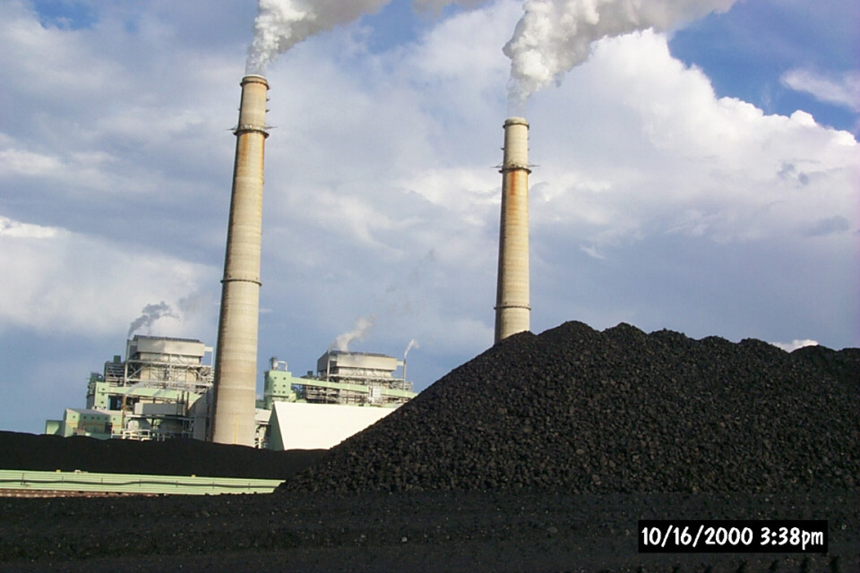
Coal, gas and oil.
Oil experts estimate that we will use
all our oil reserves within the next 40 years! Others say we will find more.
Advantages | Disadvantages
Relatively cheap to produce but prices are rising. | The resources are running out. Most scientists believe they are heating up our planet. They pollute the air we breath and produce acid rain which damages buildings and crops.

Slide 9
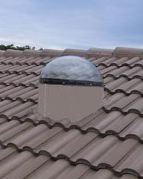
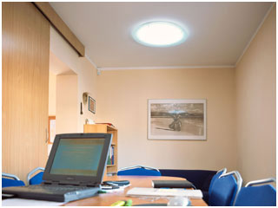
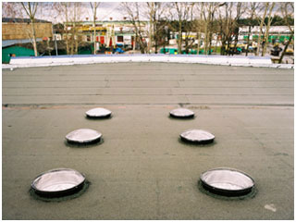
Sun tubes
Sun tubes reflect natural daylight down through a tube into a home or office. They are a great way to save energy during the day.

Slide 10
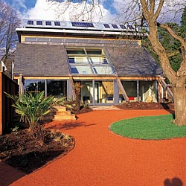
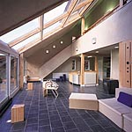
Natural lighting
‘Ty Gwyrdd’ at St. Fagans
The south face of the House is extensively glazed to maximise solar energy.

